Slide 1
ML - Regression
ICT Learning Centre @ UL - Python and ML Foundations

Slide 2
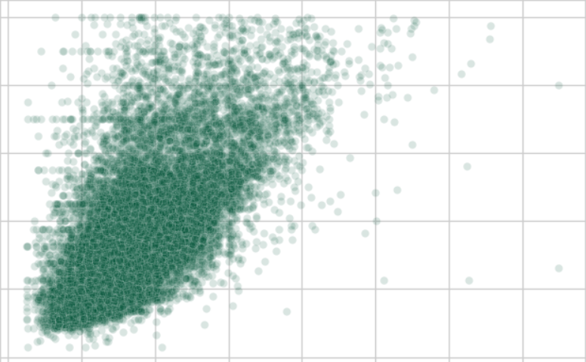
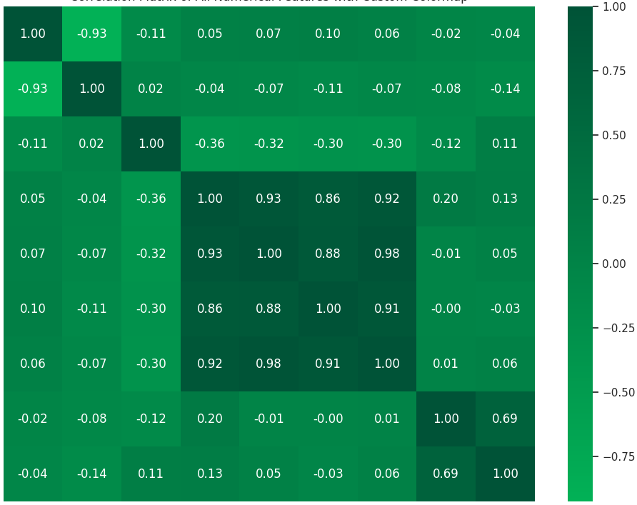
Where we left off…
California housing dataset
Median income – median house value

Slide 3
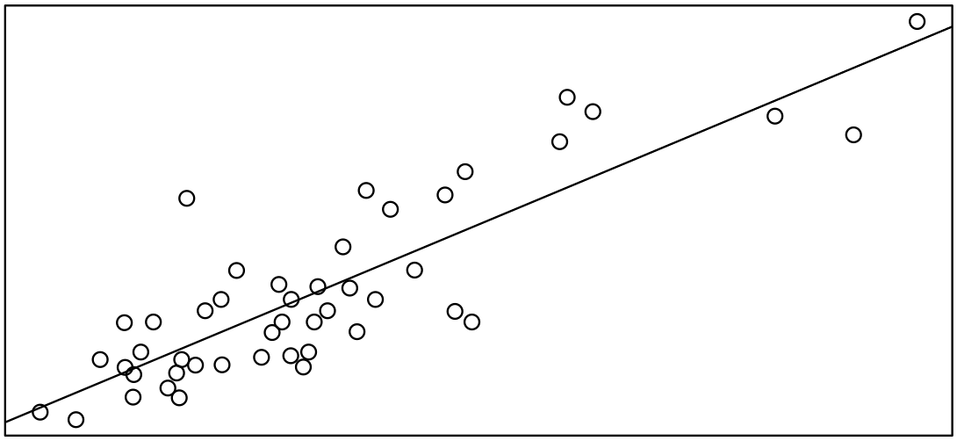
Regression
Predicting numbers

Slide 4
Supervised Learning
Model learns from ‘known’ data (labelled)
Makes predictions on unseen data

Slide 5
Supervised Learning
Model learns from ‘known’ data (labelled)
Makes predictions on unseen data
Classification
Continuous
Categorical
Regression
Classification

Slide 6
What is regression?
We try to find a single “best-fit” line that describes a pattern (from data).
<Draw simple regression model representation with line on points. Deliberately make it a poorly fit line>

Slide 7
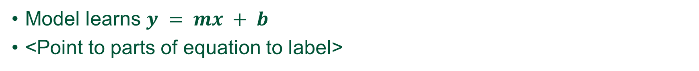
Linear regression
Model learns $y = mx + b$
<Point to parts of equation to label>
Model tries to find perfect slope, m and intercept, b for line.

Slide 8
How does it “learn”?
Model measures error or residual.
$Error = y − \hat{y}$
<Point to parts of equation to label>
<Draw simple regression line model with distance to points to show error>

Slide 9
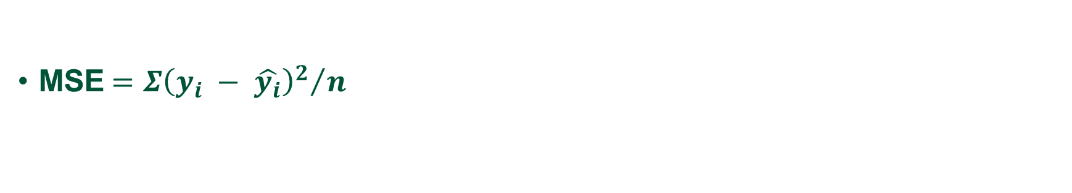
Mean Squared Error (MSE)
Loss function – measures total error.
MSE$={{Σ\left(y_{i} − \hat{y_{i}}\right)}^{2}}/n$
Best fit line → lowest MSE
<Draw simple regression line model with distance to points to show error. Show different line orientations to eventually find best fit.>

Slide 10
Train-Test Split
Need to split the data
To objectively test the model
Dataset
Training set
Testing set

Slide 11
Why split the data?
Avoid overfitting.
Model should not “memorise” data.
Model should generalise.
Dataset
Training set
Testing set

Slide 12
Practice Question
Continuing with the video game sales dataset…

Slide 13
Thank you
ICT Learning Centre,
CS1-046,
CSIS Building,
University of Limerick,
http://ictlc.ul.ie/contactus

